Slide 1
Database Management Systems Expenditure distributor Management
By
Froilan Bruno Anthony (2110030343)
V. Neha Reddy (2110030132)
K. Neha Chowdary (2110030180)
P. Sathwik Reddy (2110030191)
Under the guidance of
Mr. Sumit Hazra

Slide 2
Problem statement and domain
The main problem all the people face is not having track of their investments/expenditures.
We are going to put an end to the above stated problem by creating a web application which keeps a track of users investments and expenditure.

Slide 3

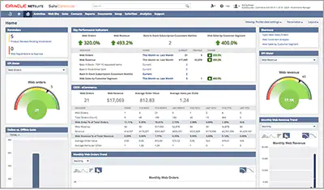
Existing solutions/ Naïve solutions
There is no proper web application or an app on Expenditure distributor Management.
But there are some applications like Infor Cloud ERP , NetSuite which are industry specialized enterprise resource planning solutions for manufacturers and distributors.

Slide 4
Proposed Algorithm Design Technique
What is the technique - The technique proposed is the EER diagram of the Database and using SQL queries to access the database. The EER model gives basic idea to the team to develop the project.
How is it suitable for your application - The database is used to store all the content of the app, the content is accessed based on the preferences of the user, and this helps to deliver the most relevant content to the user.
What do you know about the solution of it using proposed design method - The EER and ER diagrams give the basic idea and understanding of the entity and attributes amongst the team of developers and makes the development process easy.

Slide 5
PERKS
This helps us to get rid of the need for paper responsibilities
utilized by any individual to govern their income expenditure
On a weekly, monthly, and yearly basis, details of expenses will be displayed

Slide 6
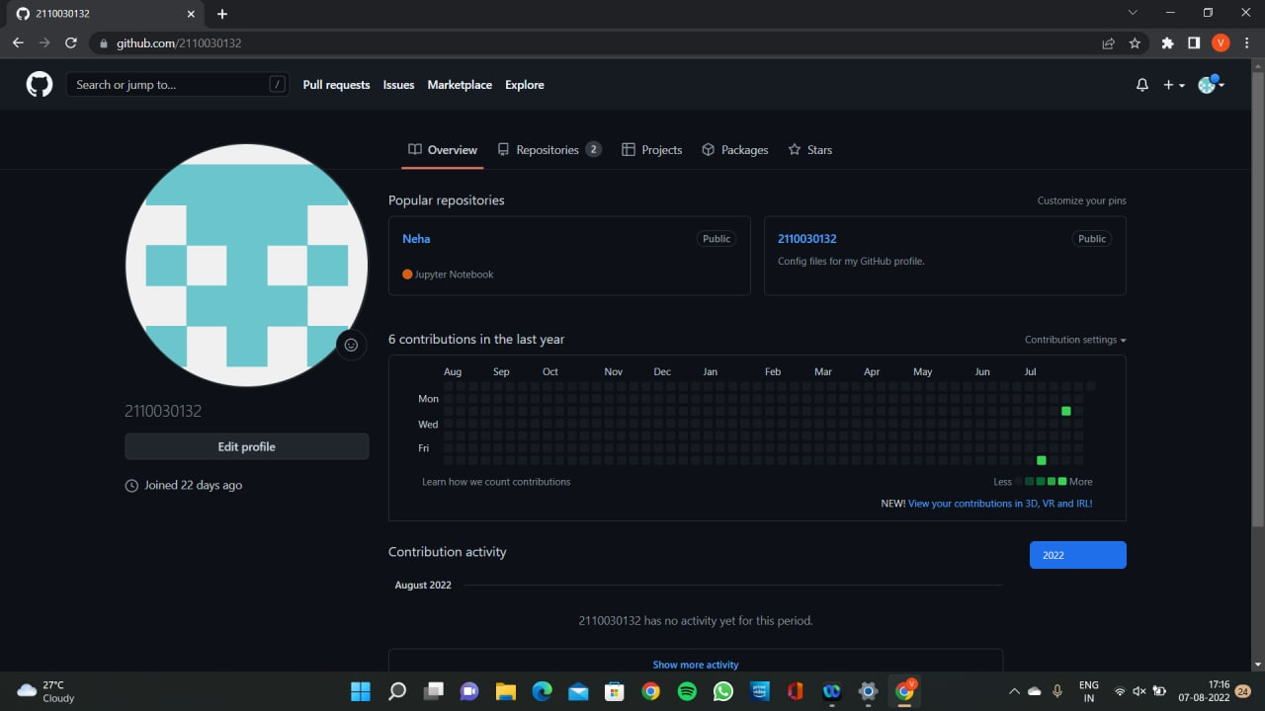
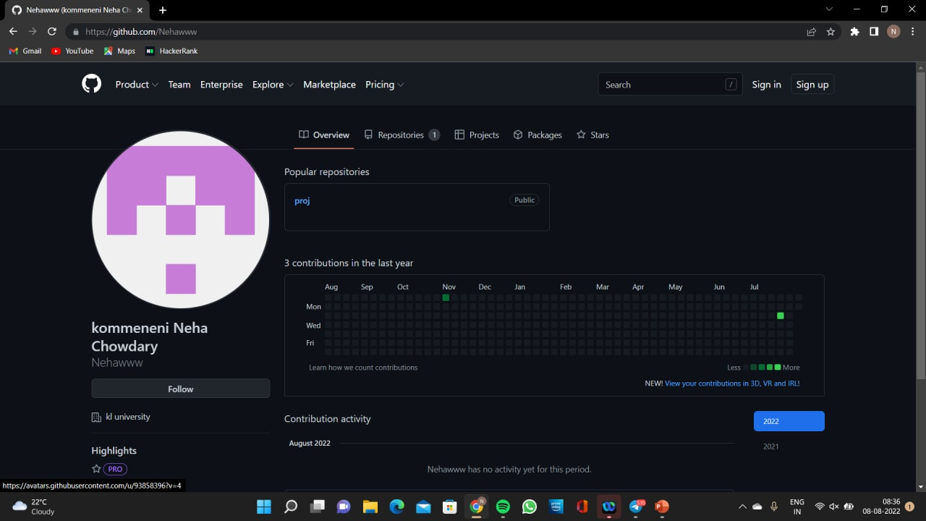
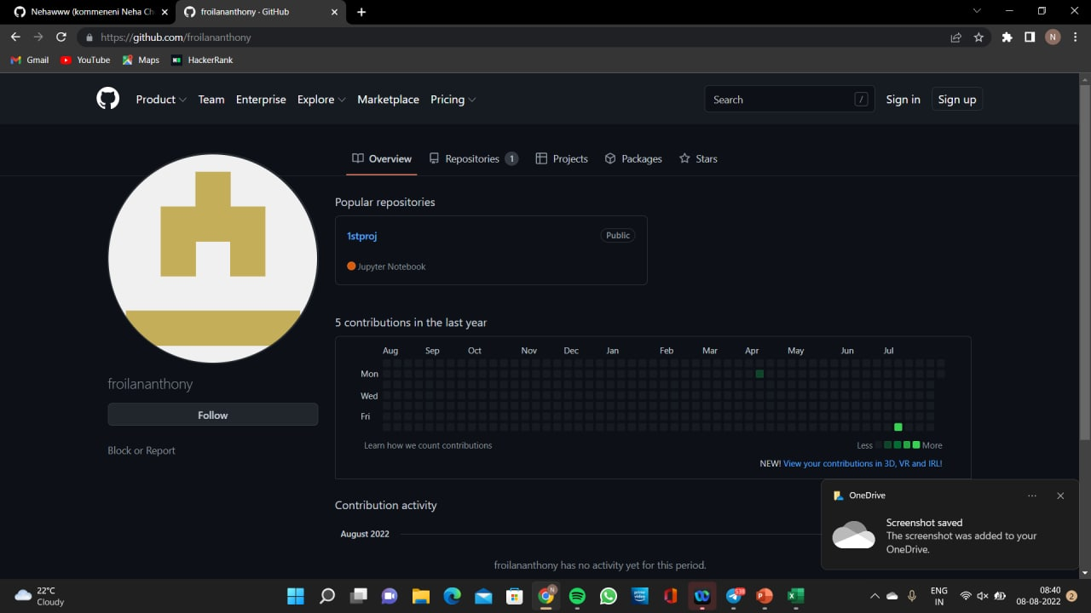
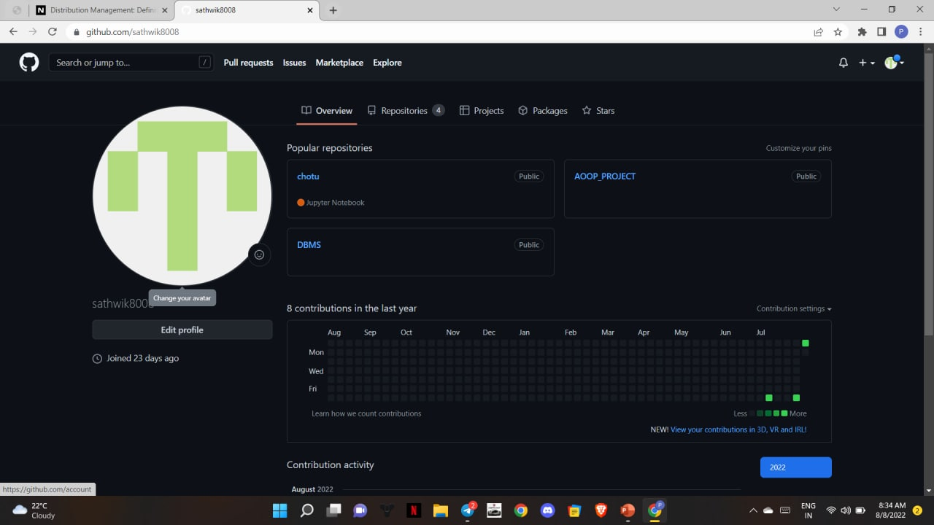
Github setup

Slide 7


TOOLS USED

Slide 8
Division of work among the group members
2110030343 Frolin Bruno Anthony - ER Diagram
2110030132 Neha Reddy - Existing solutions/ Naïve solutions
2110030180 Neha Chowdary - Problem statement and domain
2110030191 Sathwik Reddy - Research records

Slide 9
THANK YOU

